Slide 1

Financial Data Science For Implementing Pairs Trading Strategy
Presented by: Group 6
Kuntoji, Rohan – 22202093
Parary, Aman - 18417714
Fernandes, William - 22201553

Slide 2

Profit from exploiting believed market inefficiencies, generally determined through statistical & econometric techniques Pairs trading is one of the earliest & simplest forms of statistical arbitrage First introduced in the mid 1980s by a group of analysts working at Morgan Stanley
What is Arbitrage trading?
Why stock-clustering?
GICS vs ML based stock-clustering

Slide 3

1. Novel Data Set

Slide 4

Dataset Collection
Stock universe – S&P 500 constituents as of March 2023
A novel stock universe database was created by gathering generic profile data, historical financial ratios data and historical price (OHLCV) data (13 years).

Slide 5
2. Database Creation and Querying

Slide 6

SQLite - data gathered from multiple sources housed in a disk-based lightweight DB (structured data only)
5 distinct DB tables – 4 linked & 1 unlinked
Executed queries to extract data for each table to perform exploratory data analysis (EDA), data cleaning, and model building.
Sample statistics
Filtered the top 10 trading days with the highest total volume across all tickers
Extracted the top 10 sectors based on number of companies
Filtered the "HQ" attribute (state, country) to extract the top 10 companies based on each state

Slide 7
3. Cleaning, Checking and Organization of Data

Slide 8
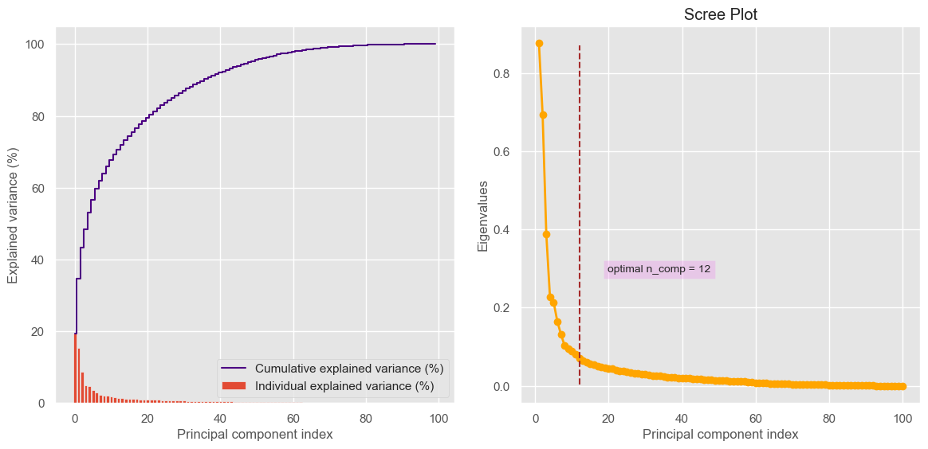
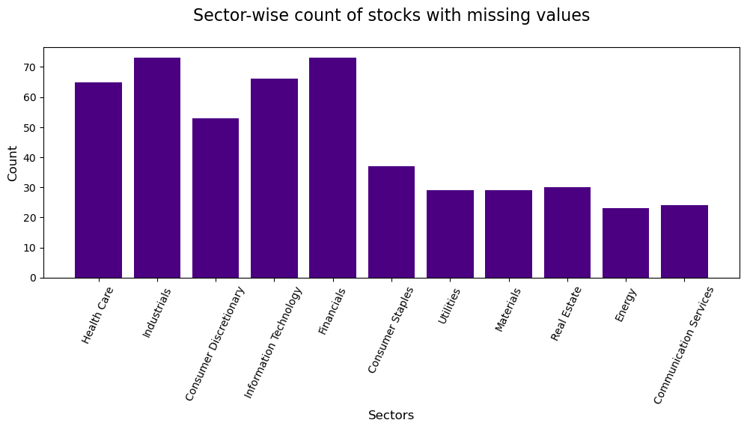
Data Imputation & dimensionality reduction (PCA)
Target financial ratios (10 out of 56) were selected based on 5 main categories – liquidity, leverage, efficiency, profitability & market value ratios
Considered only pre-pandemic historical annual ratios data (2010-2019) to fit the clustering model to avoid volatility driven bias in grouping stocks
KNN imputer was used to impute missing values in the ratios dataset, reducing missing values to zero
Employed PCA to reduce feature space dimensions by selecting the optimal number of features

Slide 9
4. Textual Analysis

Slide 10
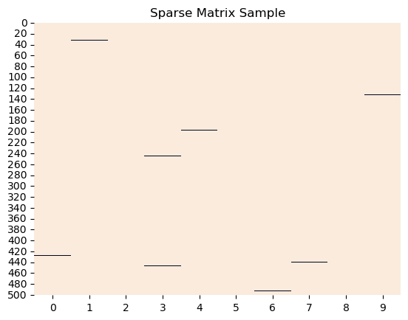
Textual data pre-processing – stop-words removal, lemmatisation, and tokenisation
Vectorised textual data to transform it into a numerical feature space
Feature extraction using Tf-Idf measures and n-grams
Over 10000 feature variables created by considering n-grams in range of (2, 4)

Slide 11
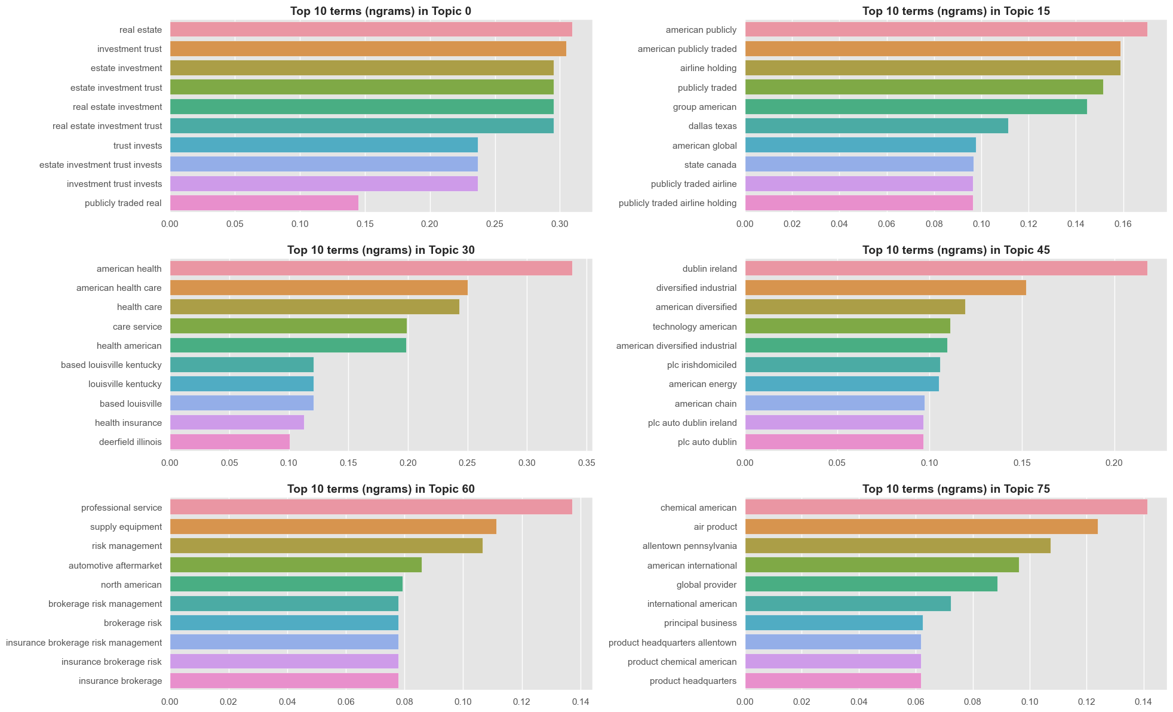
Bar charts of the top 10 n-grams within each topic
Latent Semantic Analysis (LSA) applied to reduce dimensionality of the TF-IDF sparse matrix and get a dense matrix.
Reduced feature space from 10000 to 80 latent variables (topics), retaining 25% of total variance explained

Slide 12
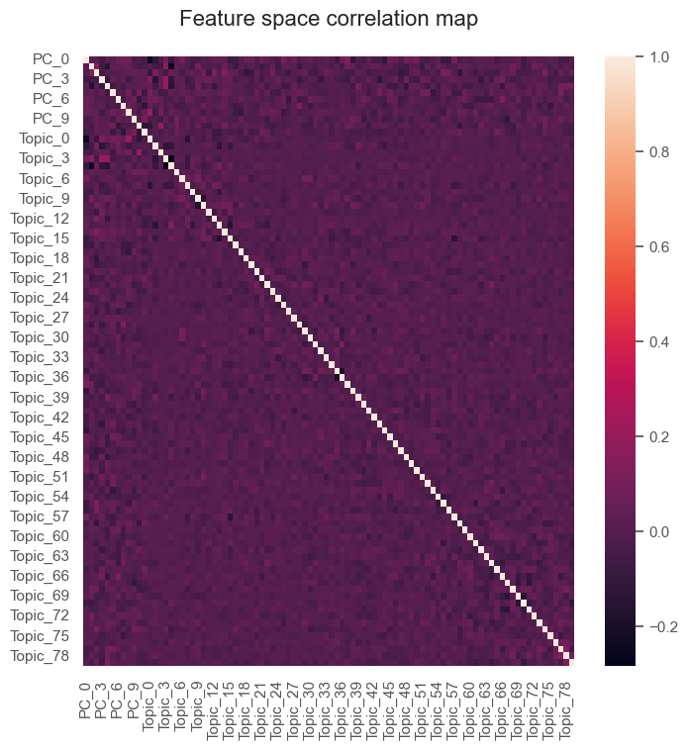
Feature space correlation map with 12-PCA & 80 LSA
Near zero feature correlation is observed in the heatmap
Uncorrelated features are better for model fitting, hence validating data pre-processing steps

Slide 13
5. ML-based modelling

Slide 14
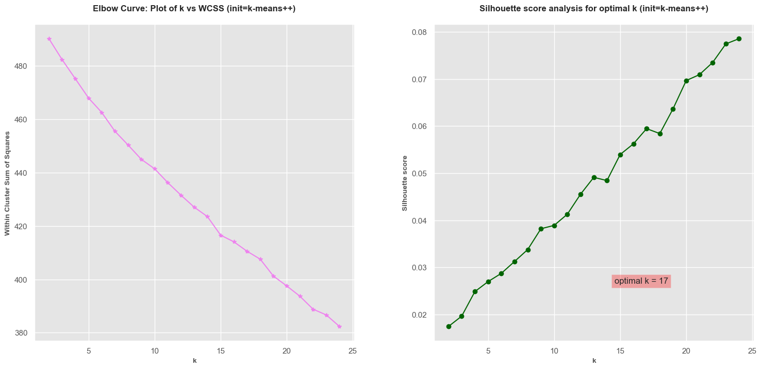
Elbow test and Silhouette score analysis

Slide 15
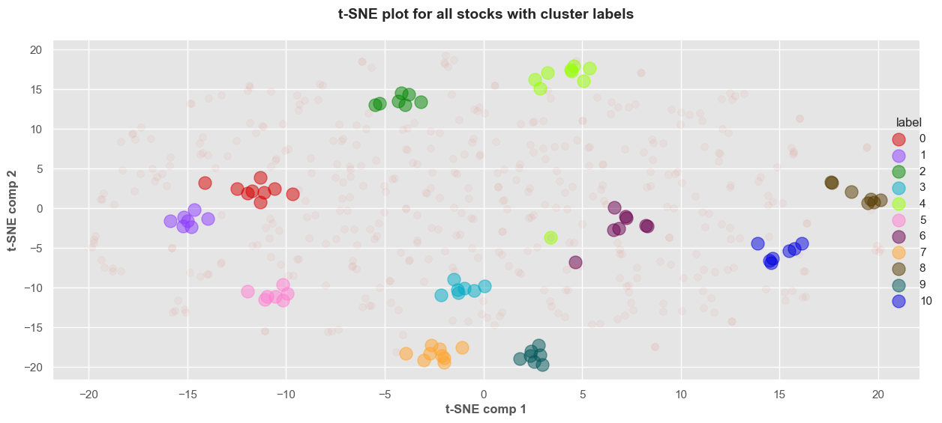
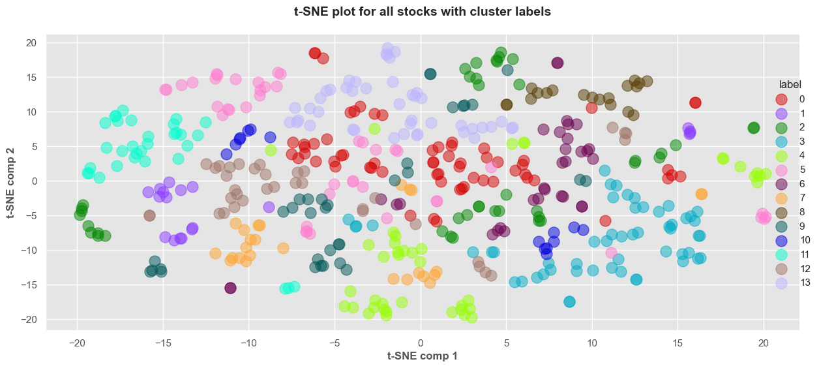
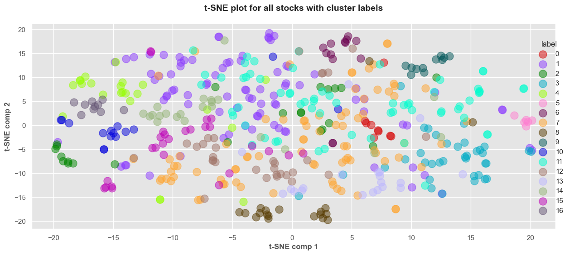
The t-SNE plot for OPTICS exhibits clear separation between clusters, well-defined boundaries, and compact clusters, indicating that this model performs favorably for the given dataset
Stock clusters t-SNE plots (3 clustering approaches)
Hierarchical clusters (14)
OPTICS clusters (11)
K-means clusters (17)

Slide 16
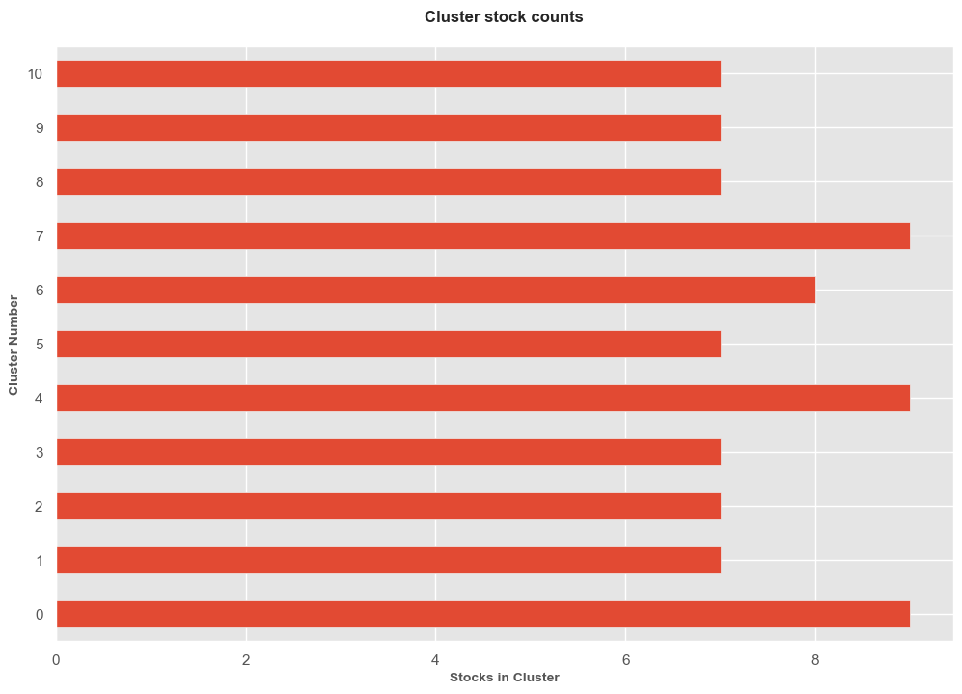

Bar chart displaying 11 OPTICS clusters with stock counts ranging between 7 and 9 per cluster

Slide 17
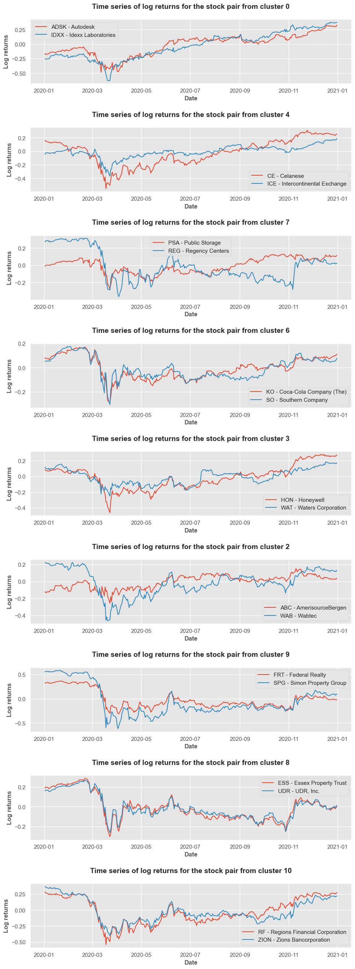
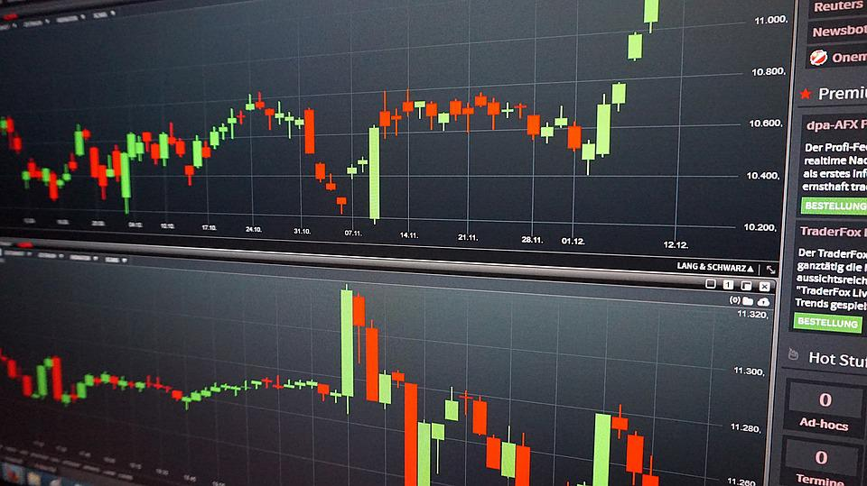
Displays 9 cointegrated pairs with a statistically significant relationship, as determined by the ADF test at a 95% confidence level

Slide 18
6. Data Visualisation

Slide 19
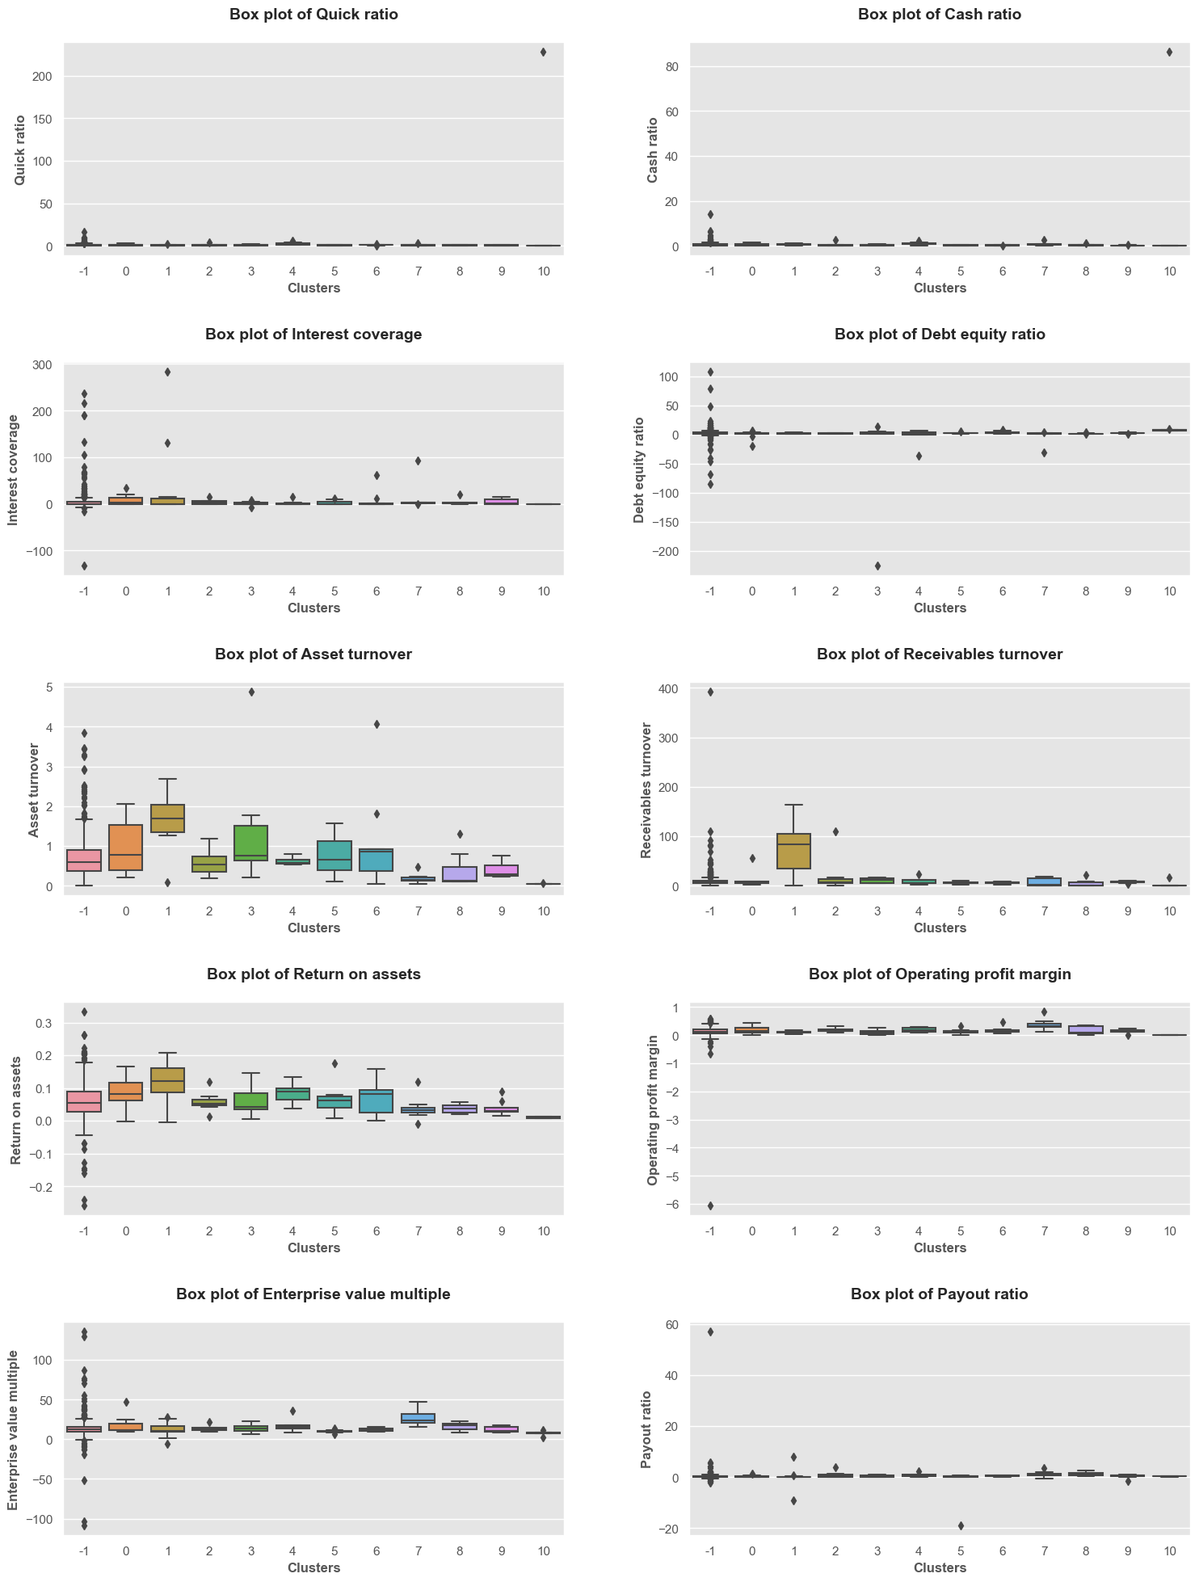
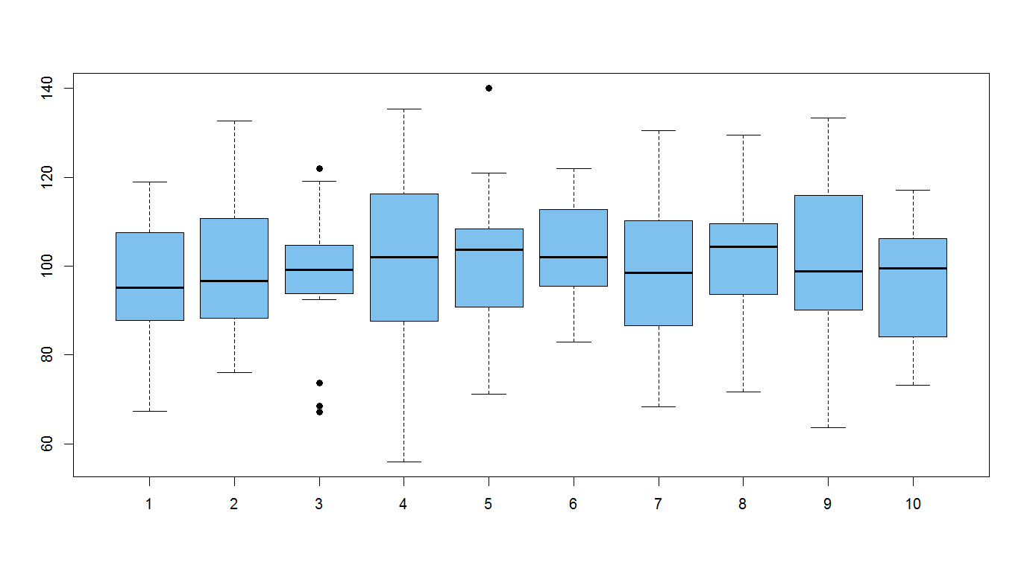
Boxplots
distribution of stocks across clusters based on different ratio measures;
describes median, outliers, and skewness

Slide 20
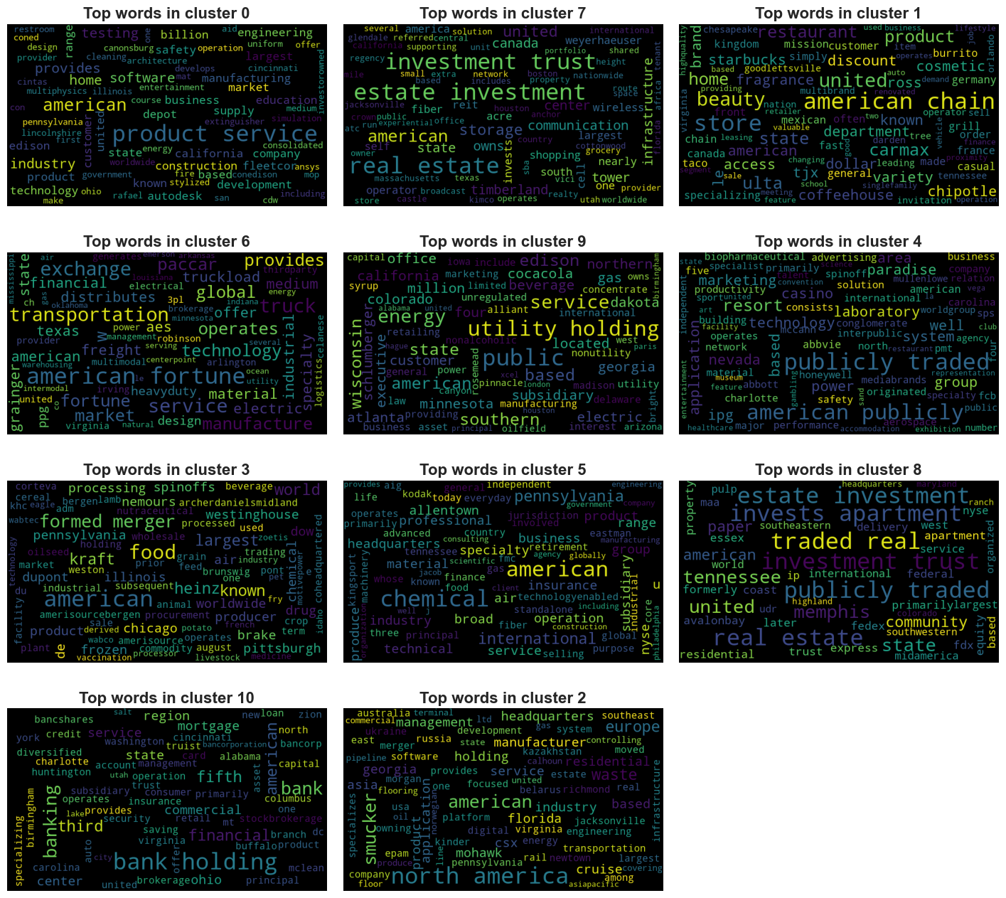

Word cloud plots reveal business descriptions for companies in each of the 11 OPTICS clusters

Slide 21
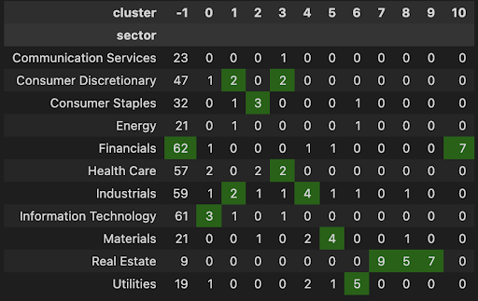
OPTICS clusters plotted against the GICS sector segmentation

Slide 22
7. Business Analysis & Future scope

Slide 23
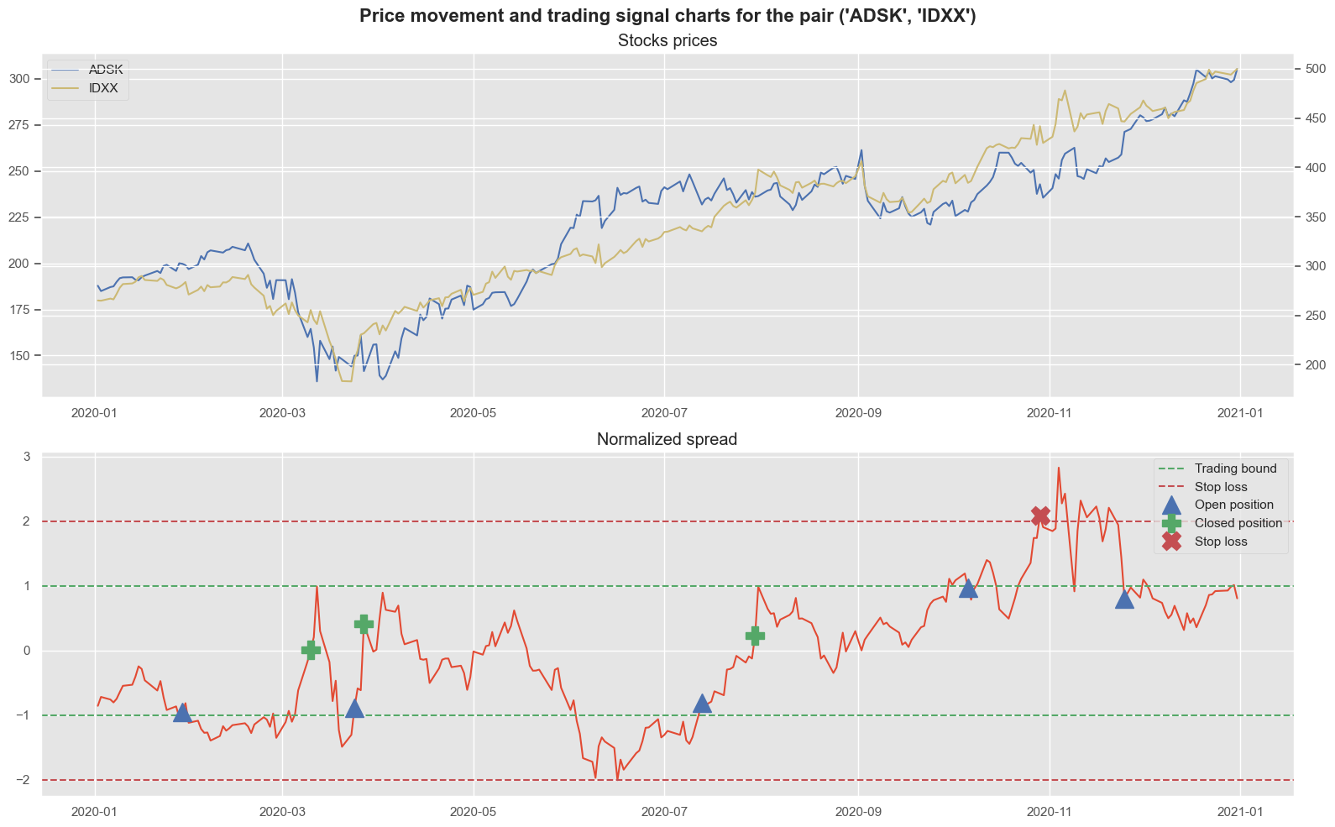
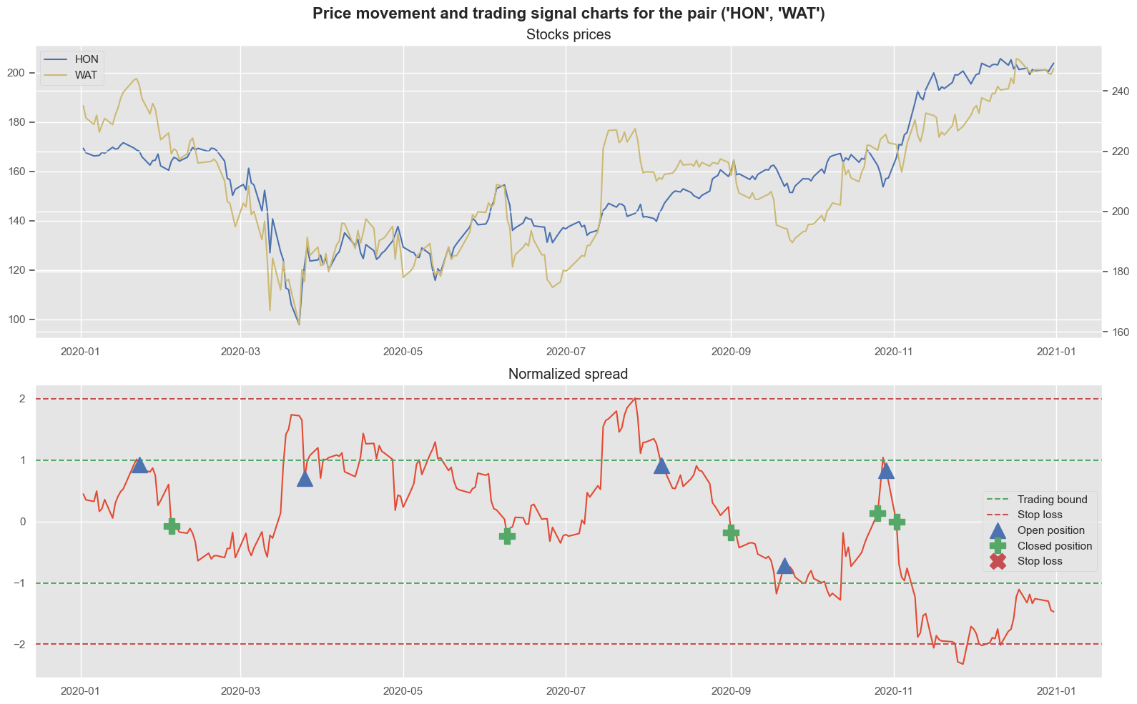
Price Movement and Trading Signal Charts
Pair [ADSK, IDXX]
p-value | 0.01244
Mean crosses | 13
Pair eligible | True
Profitable trades | 75%
Avg holding period | 14.66 days
Pair [HON, WAT]
p-value | 0.0050
Mean crosses | 13
Pair eligible | True
Profitable trades | 100%
Avg holding period | 21 days

Slide 24
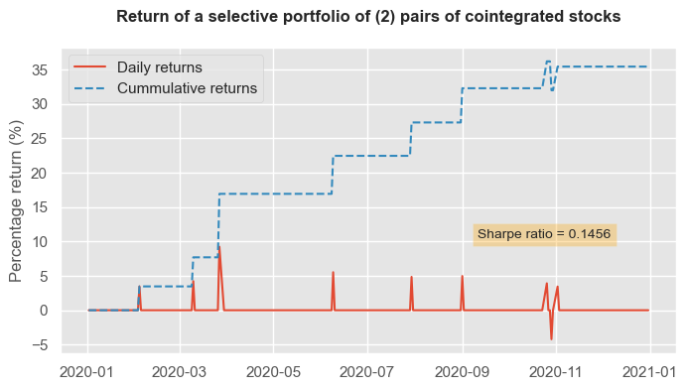
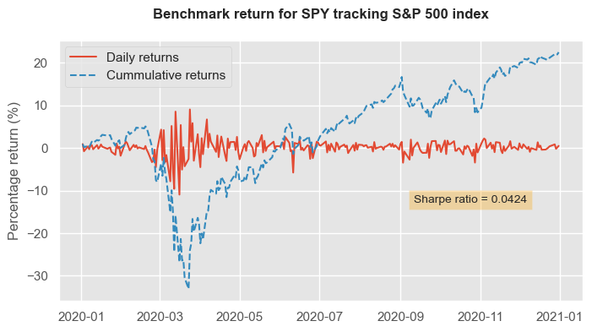

Portfolio Performance vs Benchmark

Slide 25

Conclusion
Pairs trading strategy generated higher risk-adjusted returns than the benchmark.
Investors should consider their risk tolerance before adopting this strategy, as it involves trading specific pairs of assets.
Longer-term analysis is necessary to evaluate the effectiveness of the strategy.

Slide 26

Thank you

